Slide 1



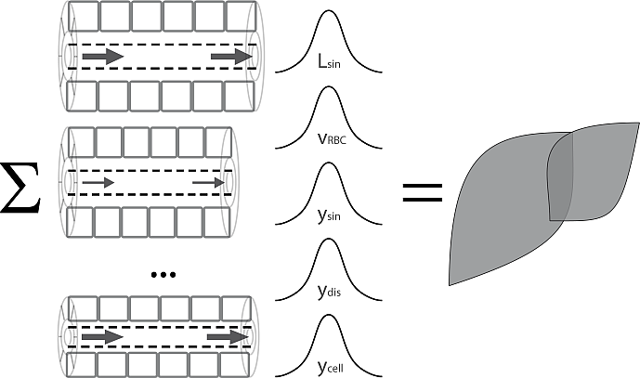
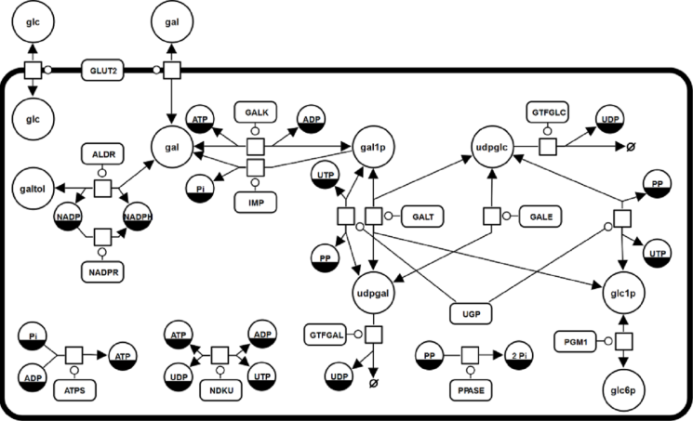
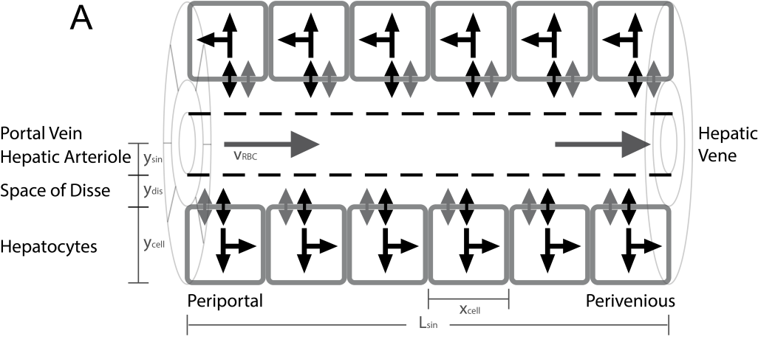
From Hepatocytes to Whole Liver Function: A Multi-scale Model of Human Galactose Metabolism - Sampling Parameter Distributions König M. & Holzhütter HG.

Slide 2
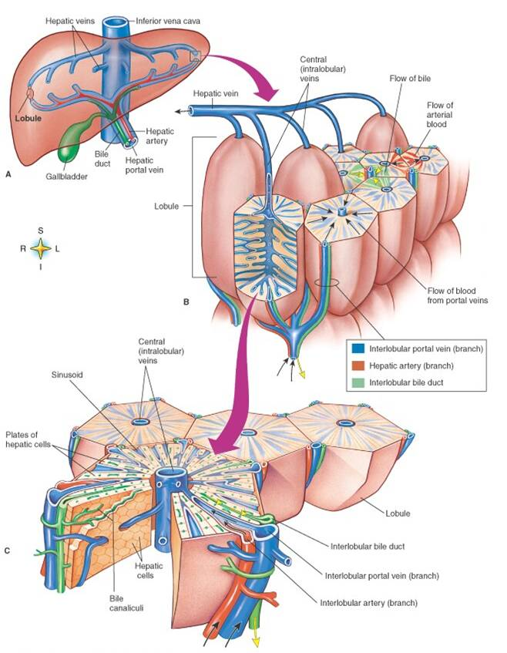
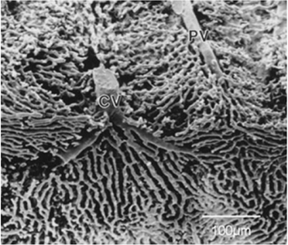
Liver Architecture
Liver
liver structured in parallel subunits (liver lobule)
liver lobulus consists of network of sinusoids connecting hepatic artery and portal vein with the central vene (periportal → perivenous)
Lobulus

Slide 3
Modeling Pipeline
Tissue parameter distributions
Fit distributions to experimental data
Algorithm
Method (ODE, SS, MCA)
Parameters (tolerances, stepsize,..)
Sampling Sinusoidal Unit Architectures
LHS
Distribution
Mixed
Database storage
Store models, algorithms, samplings, events, timecourses (CSV)
Reproducibilty
Simplify data analysis
Simulation
C++
Single Cell Model
Fit Vmax to experimental data
Initialization (i.e. Galactosemias)
Timecourse Events
Define changes in boundary conditions (peaks, parameters changes, …)
Postprocessing & Analysis
Probability-weighted averaging
Scaling from samples to whole liver
Generate figures

Slide 4
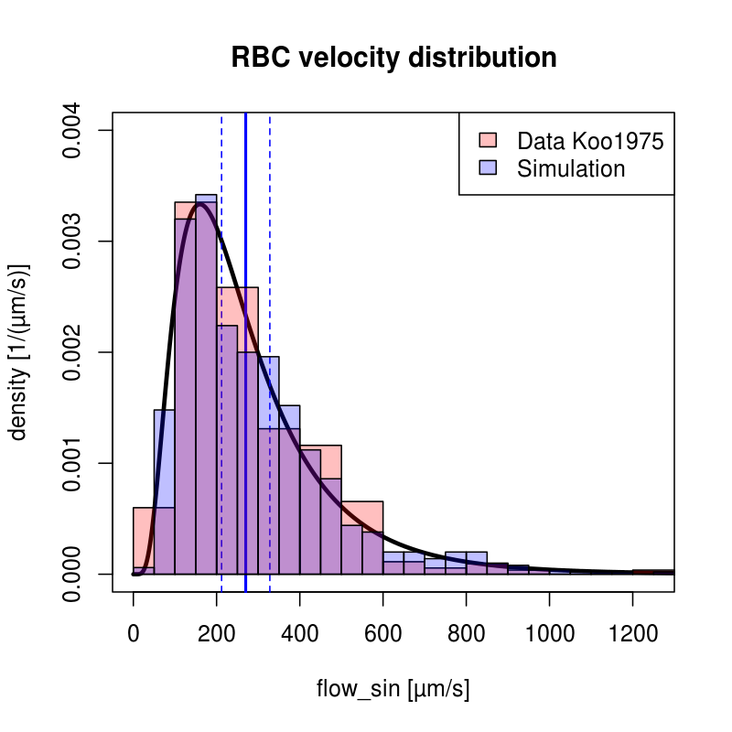
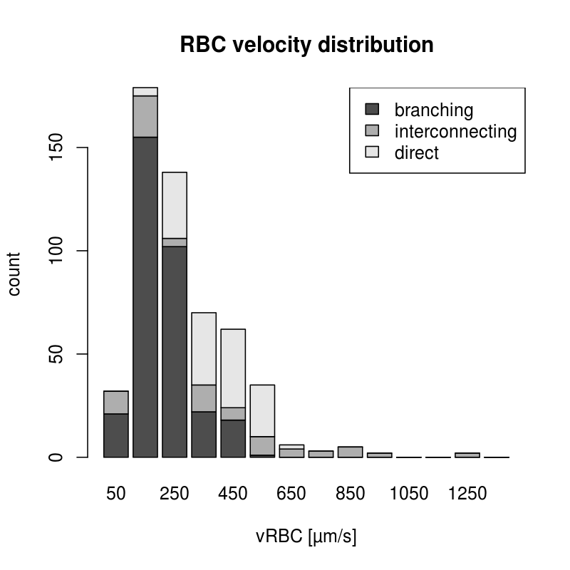
Fitting Distributions
maximum-likelihood method for univariate distributions (log-normal)

Slide 5
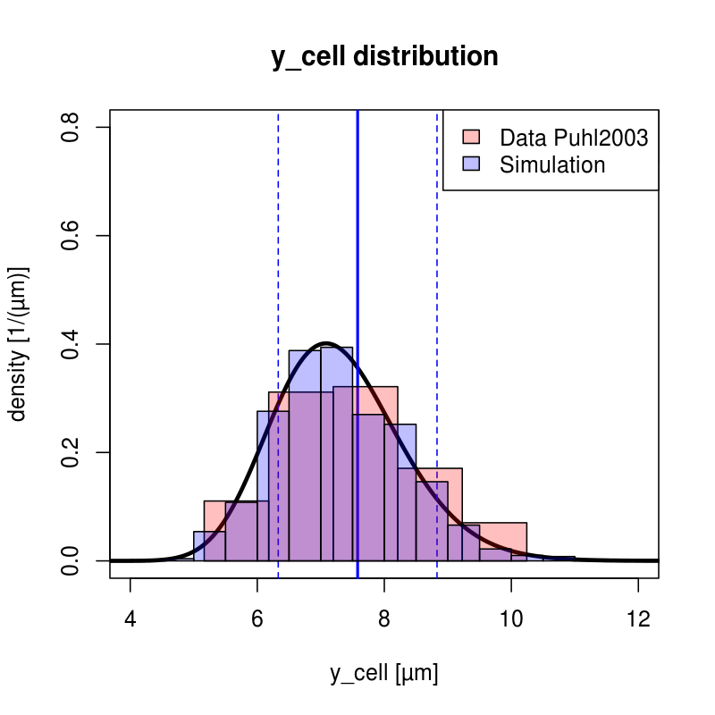
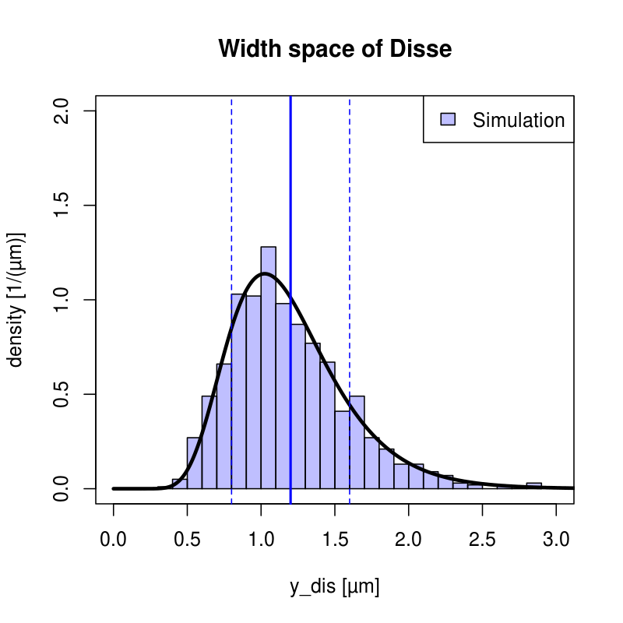
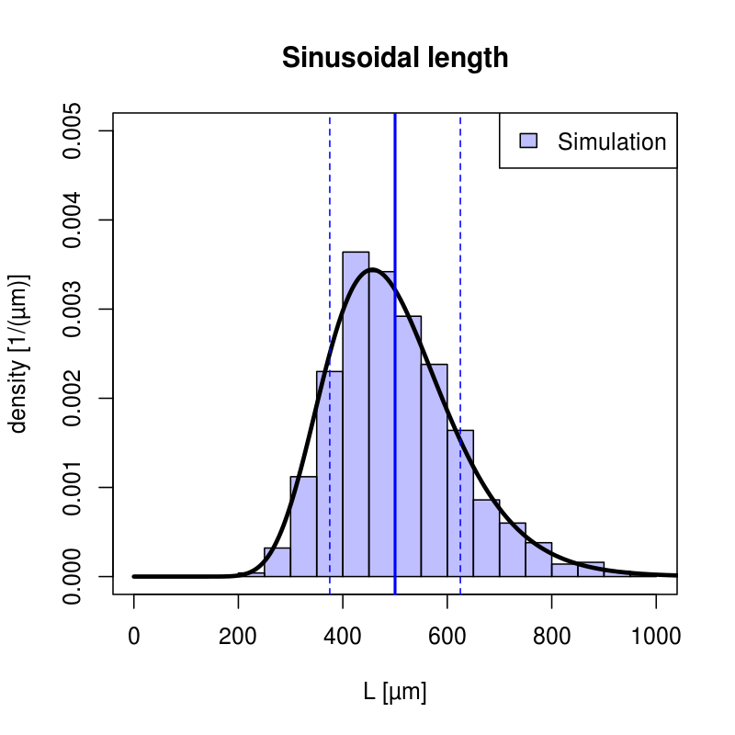
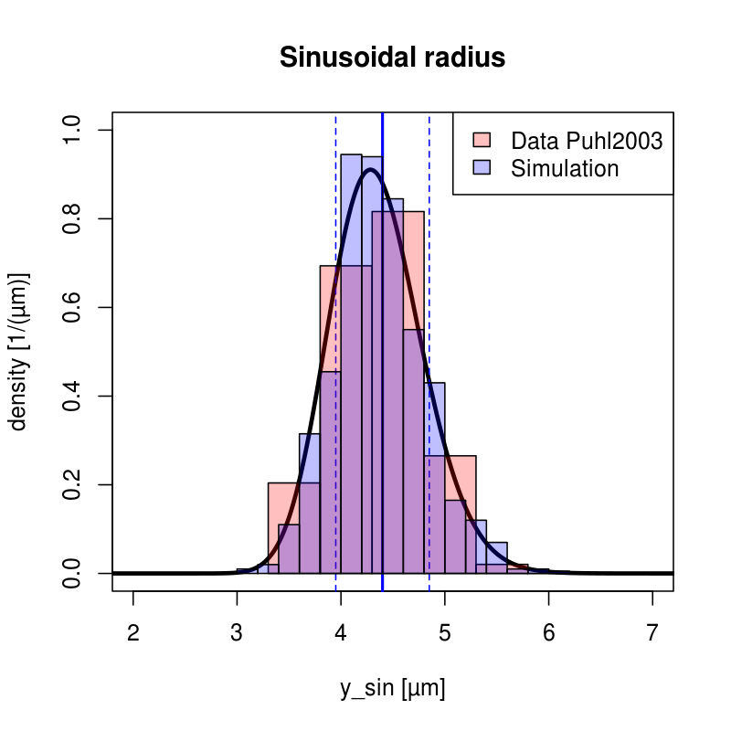
Tissue-scale Sinusoidal Unit

Slide 6
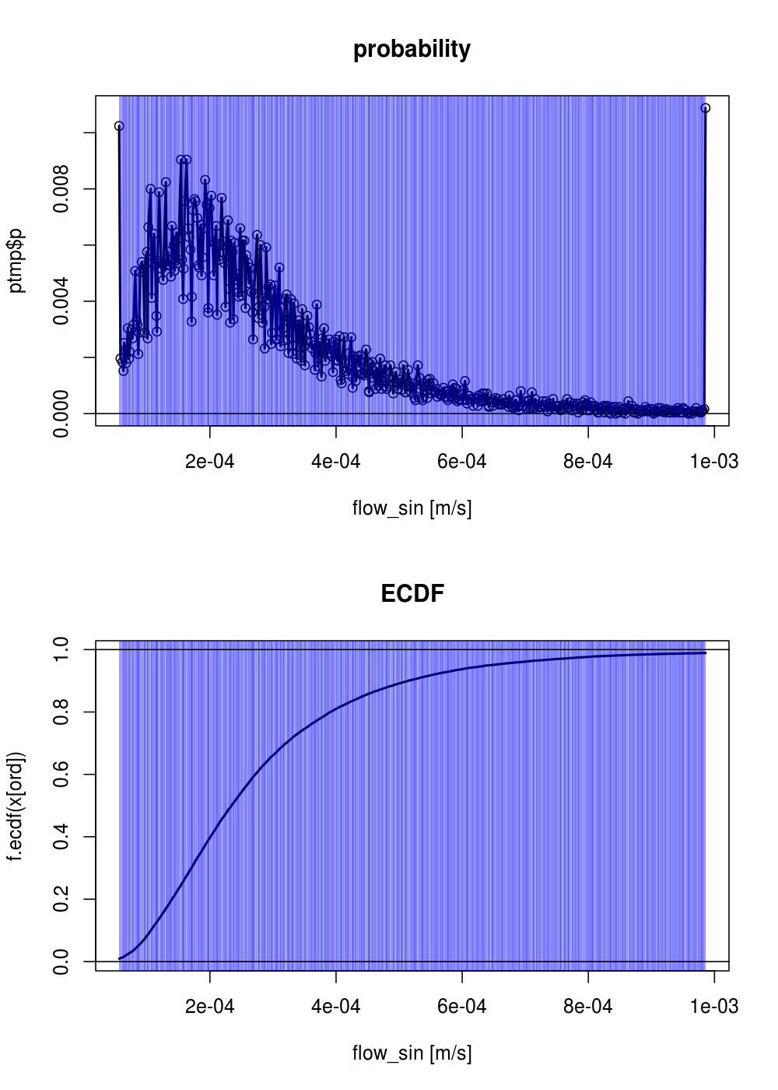
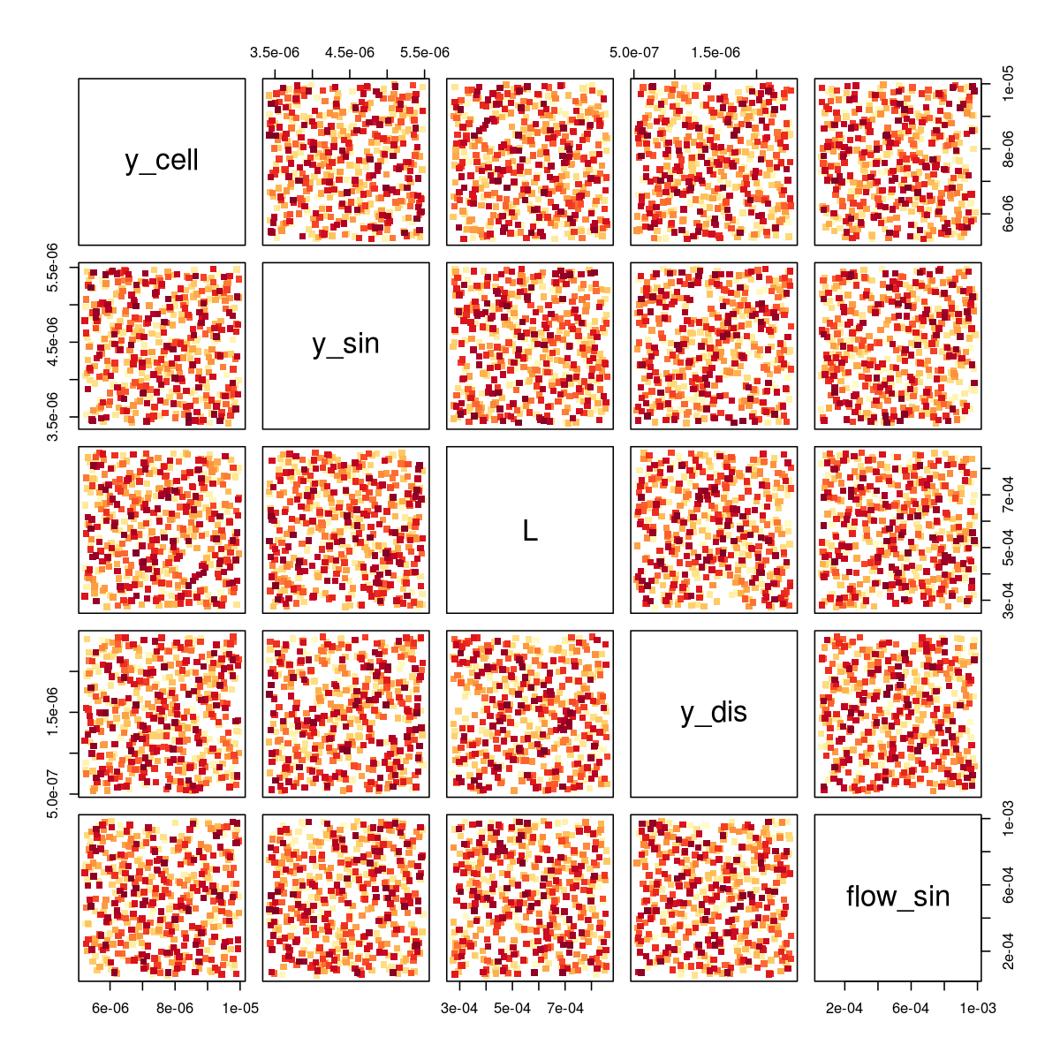
LHS Sampling
Latin hypercube sampling (LHS) & Methods from MonteCarlo sampling

Slide 7
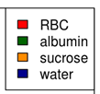
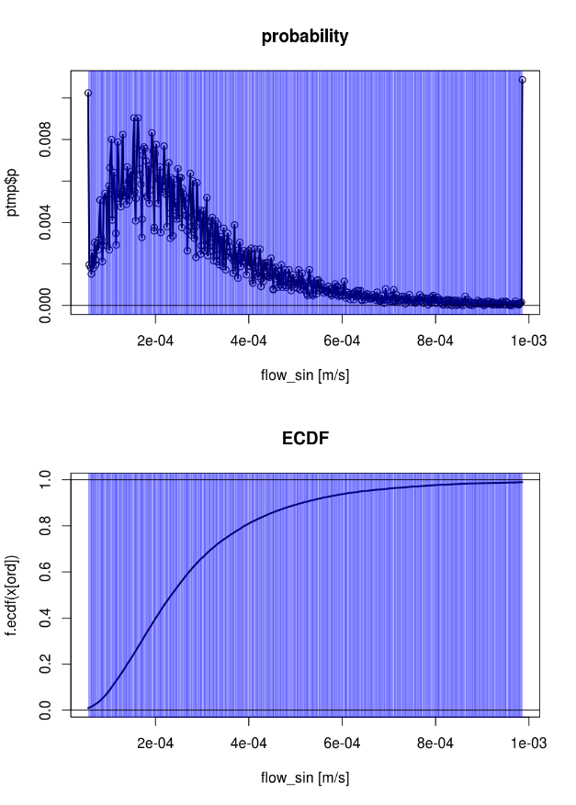
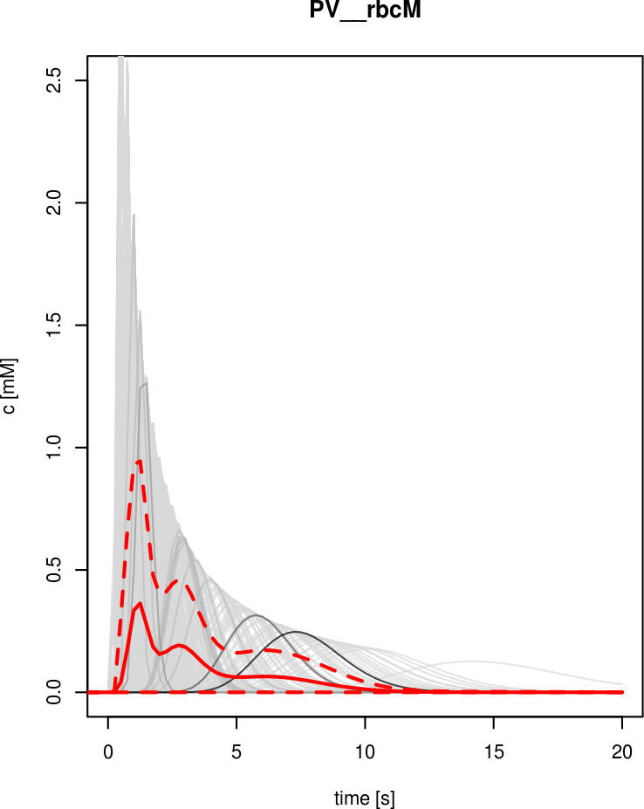
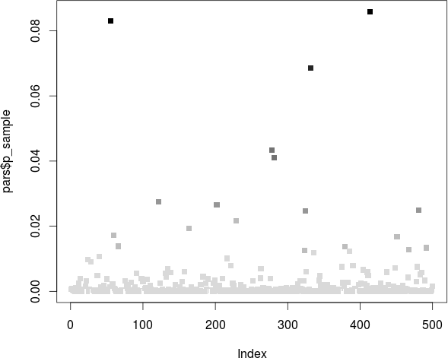
Convergence
Challenge:
High-dimensional parameter space (5-10 dimensions in tissue & metabolic parameters)
Many „clever“ samples necessary to cover space properly

Slide 8
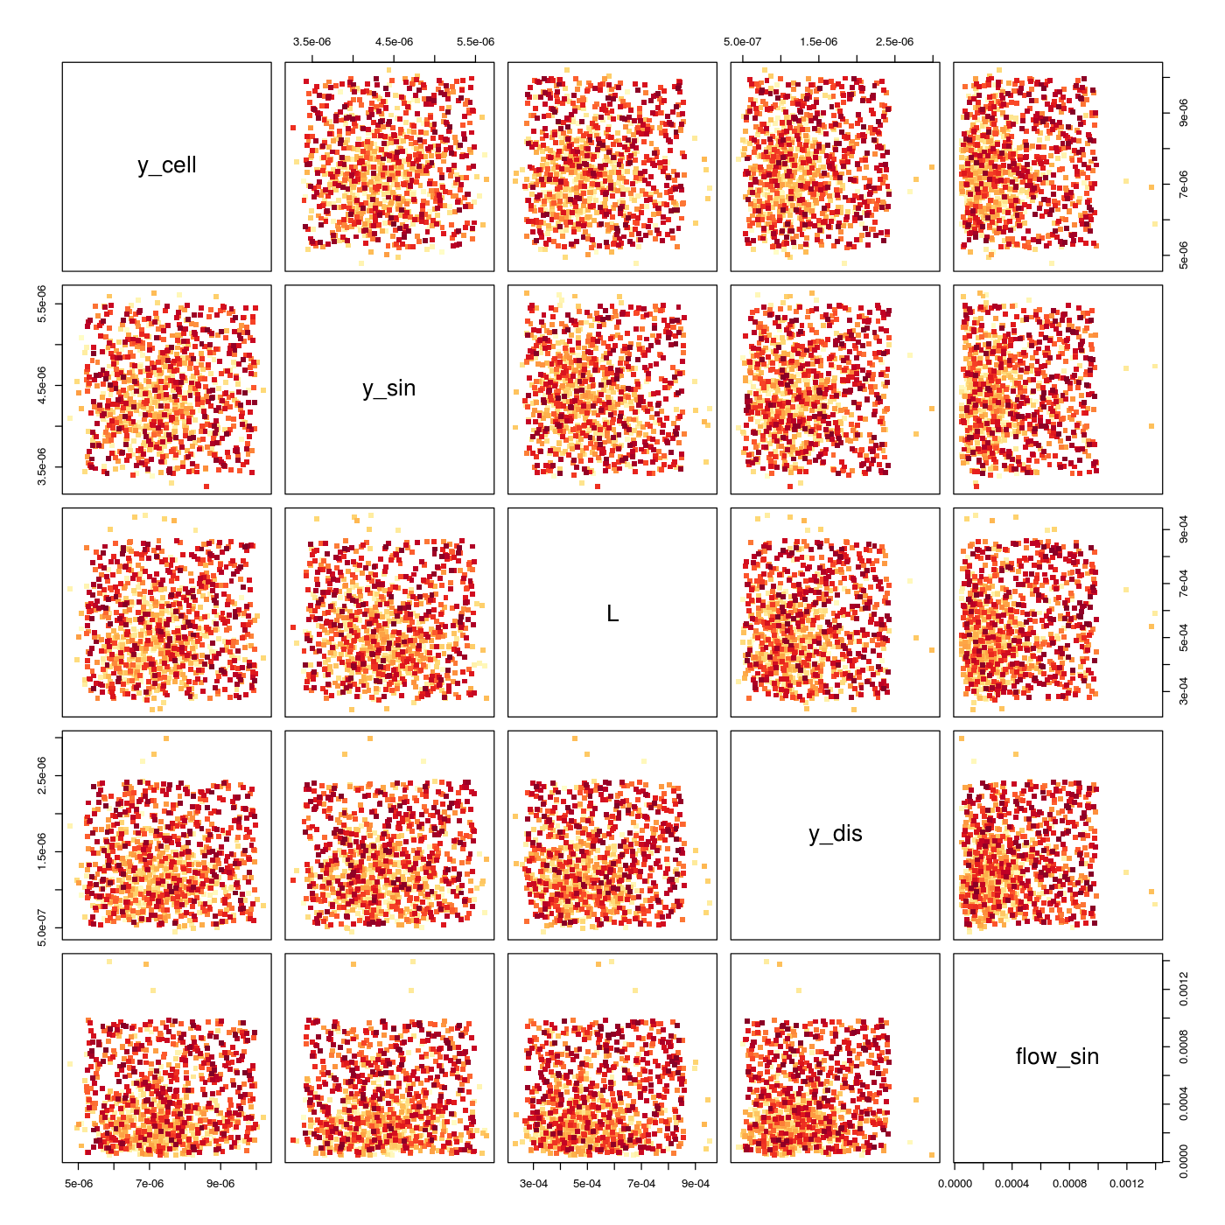
Combination Strategy
50% LHS (cover full range from 0.01-0.99 quantiles)
50% distribution sampling (account for highly probable events)
ECDF based weighting (empirical cumulative distribution function) of sample contribution under assumption of statistical independence of parameters

Slide 9
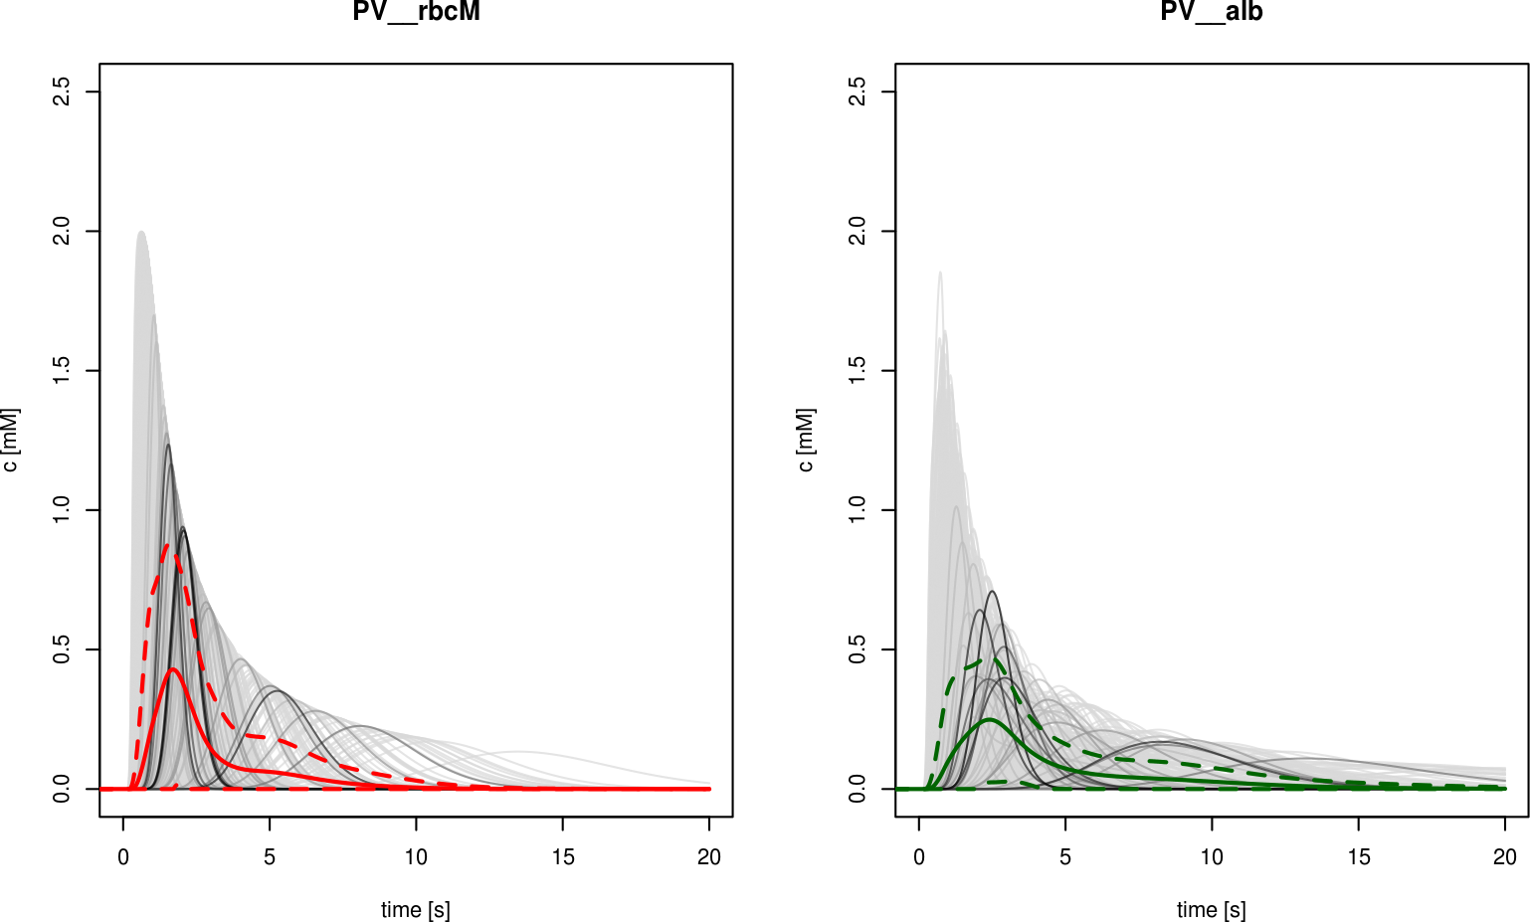
Perivenious Dilution Curves
Better, but still not optimal
N=1000 mixed (500 LHS & 500 distribution) + probability weighting
TODO: Drop the statistical independence & construct a multidimensional ECDF
Note:
Effect of additional variables in case of albumin (Disse space) compared to RBC
High variance! An integrated dilution curve is measured, but locally very high diversity in sinusoids (transition times, spread, …).
Periportal peak
0.5s

Slide 10
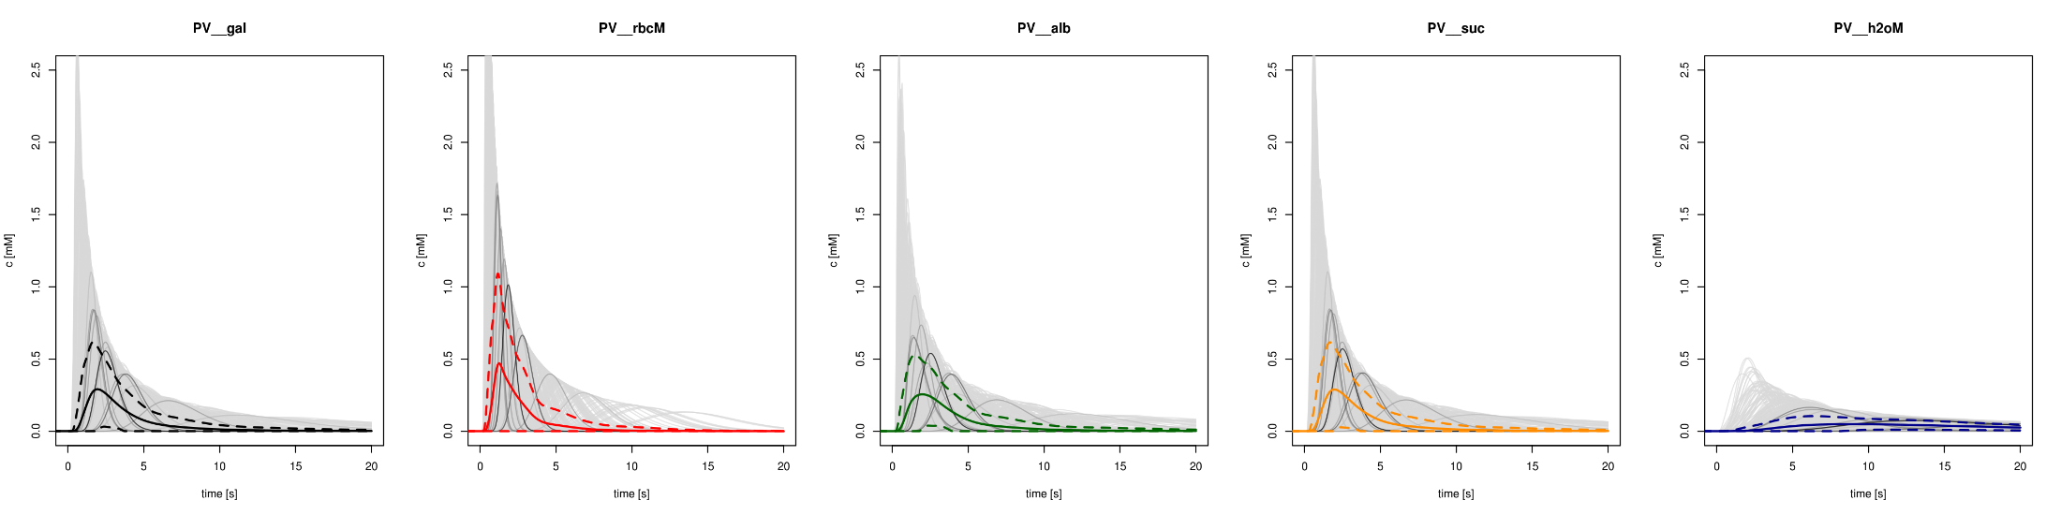
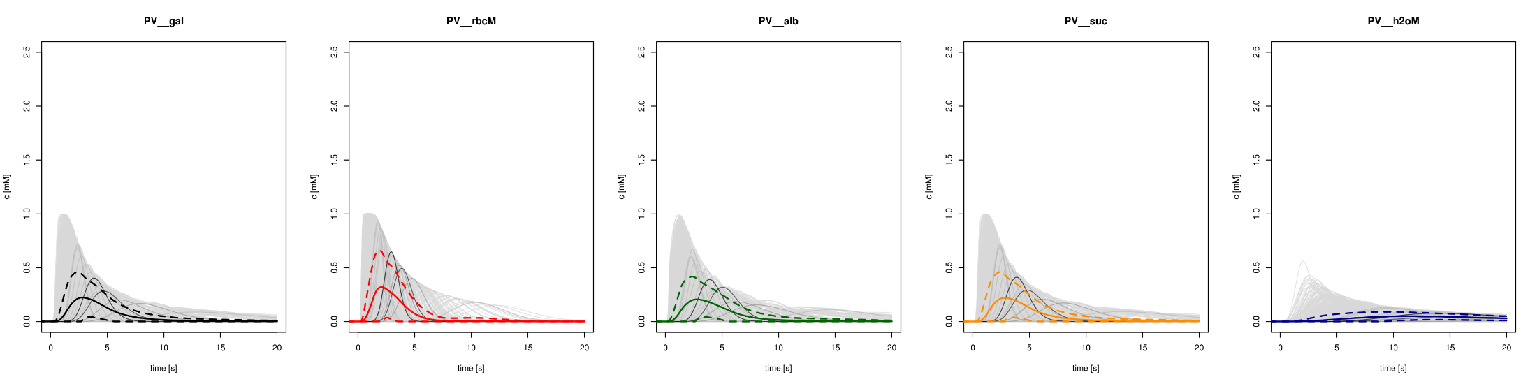
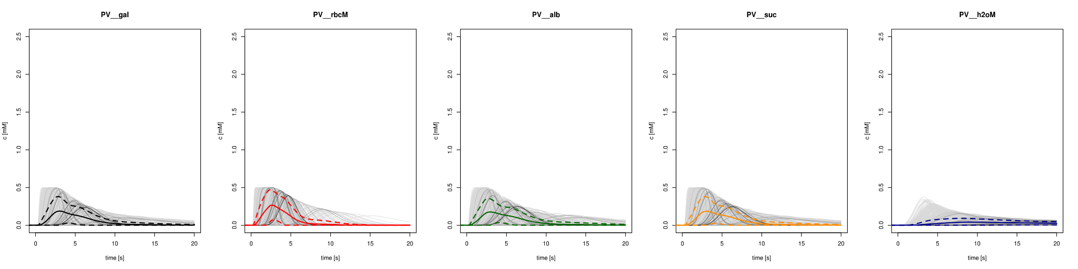
Periportal Peak
0.25s
Periportal Peak
0.5s
Increase in peak duration broadens the dilution curve,
especially the tail.
Periportal Peak
1s

Slide 11
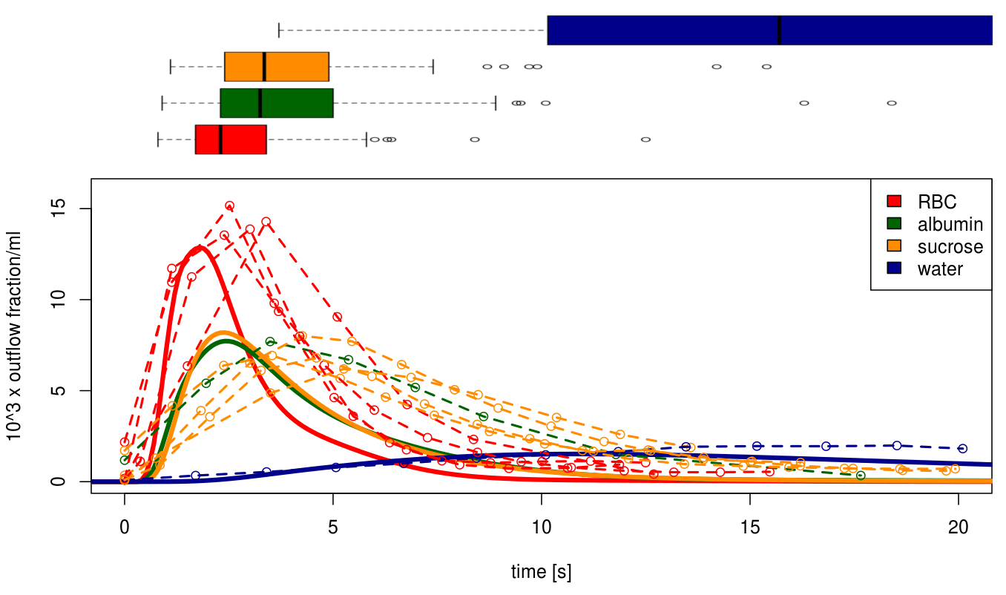
Multiple indicator Dilution
Mean dilution curves with experimental data from 4 independent experiments
Periportal Peak (rectangular, duration 0.5s)
No fitting (only free parameter is peak duration).

Slide 12
Modeling Pipeline
Tissue parameter distributions
Fit distributions to experimental data
Algorithm
Method (ODE, SS, MCA)
Parameters (tolerances, stepsize,..)
Sampling Sinusoidal Unit Architectures
LHS
Distribution
Mixed
Database storage
Store models, algorithms, samplings, events, timecourses (CSV)
Reproducibilty
Simplify data analysis
Simulation
C++
Single Cell Model
Fit Vmax to experimental data
Initialization (i.e. Galactosemias)
Timecourse Events
Define changes in boundary conditions (peaks, parameters changes, …)
Postprocessing & Analysis
Probability-weighted averaging
Scaling from samples to whole liver
Generate figures

Slide 13
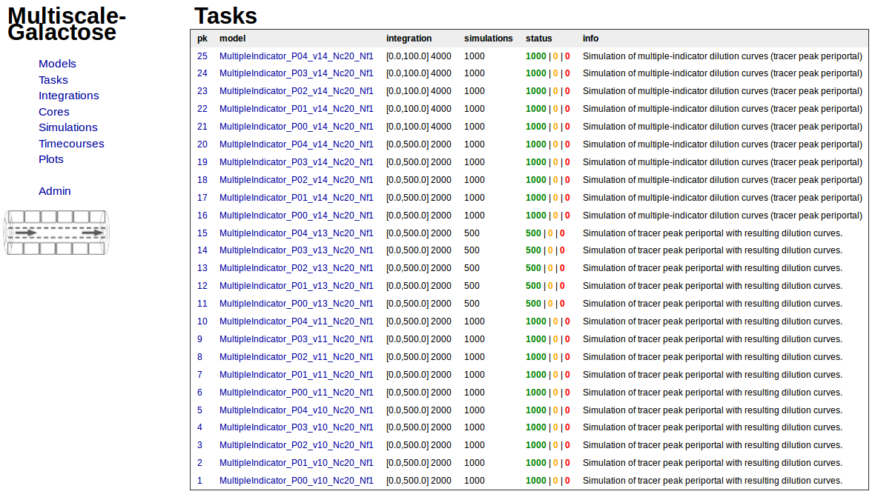
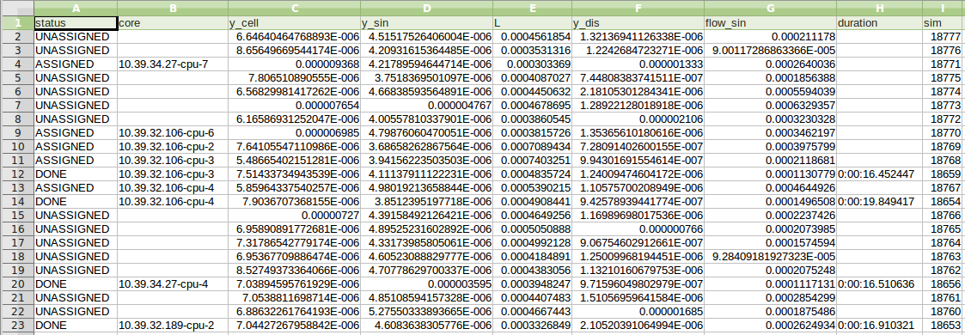

Slide 15
Organ-scale – Whole Liver Metabolism

Slide 16
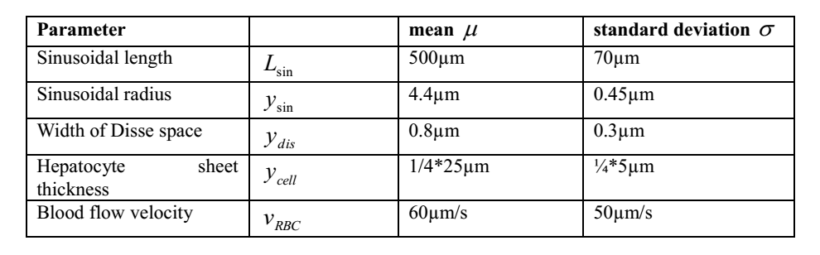
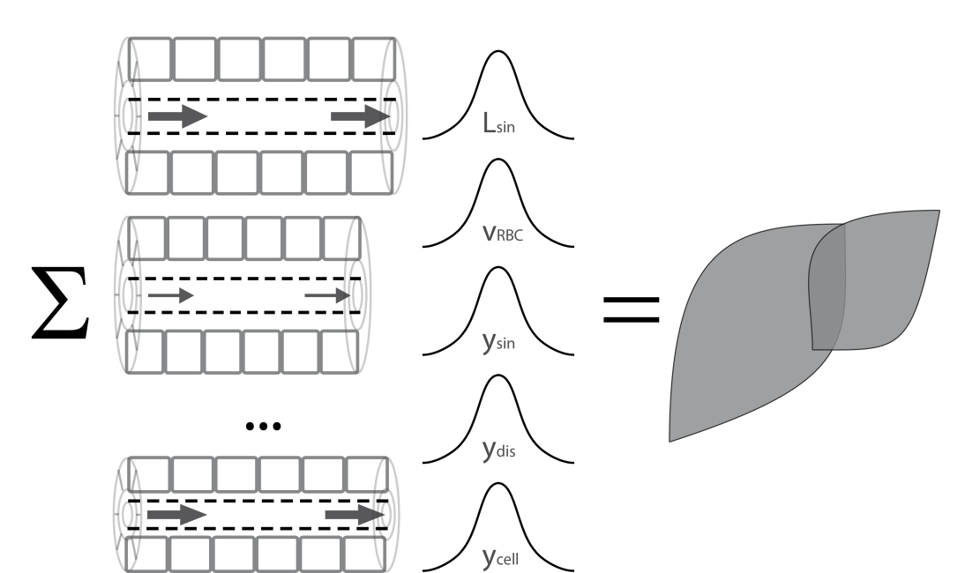
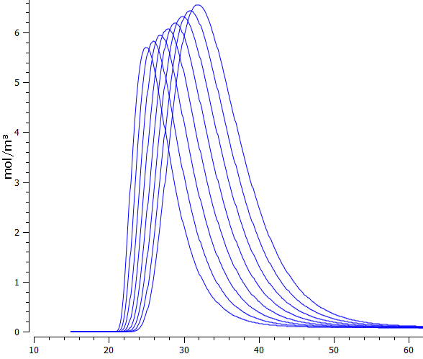
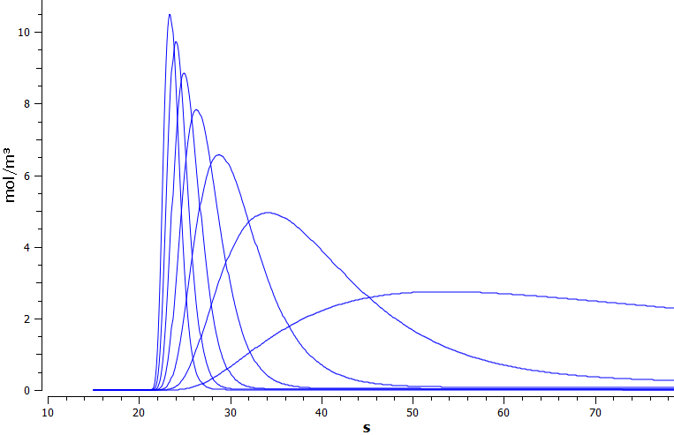
Organ-Scale
whole liver modelled by integrating heterogeneous contribution of sinusoidal units differing in blood-flow and tissue-architecture
Variation of sinusoidal
length
Variation of blood flow
time [s]

Slide 17
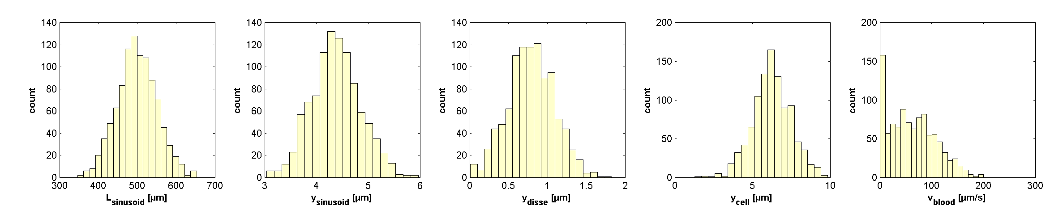
WORK in Progress
Calculation of distributions of sinusoidal units
optimized C++ integration routines
parallelization & integration
Simulations of alterations
Galactosemias
homogeneous
changes in GEC during aging
changes in GEC dring CCL4 intoxication
changes in GEC during
heterogeneous
local perfusion inhomogenities

Slide 18
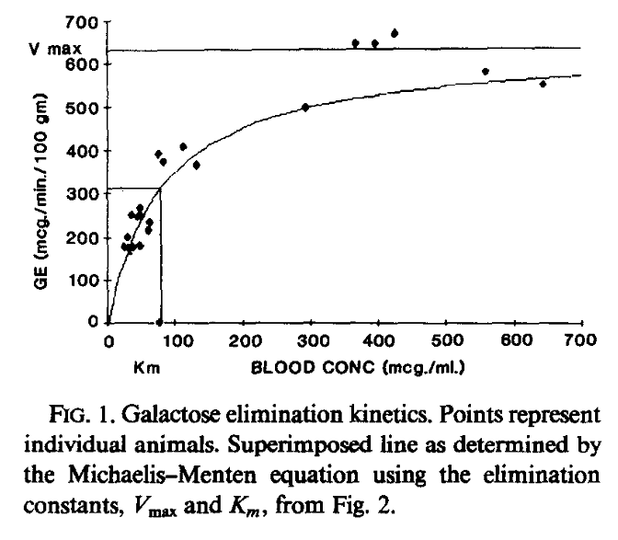
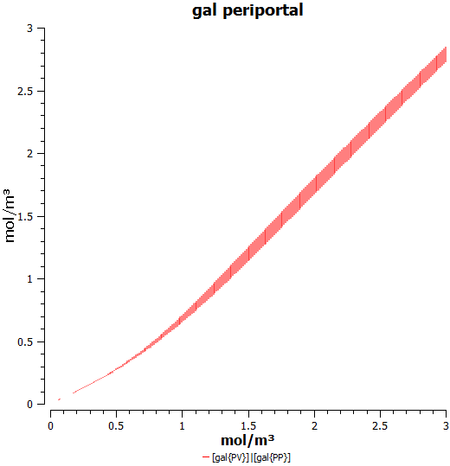
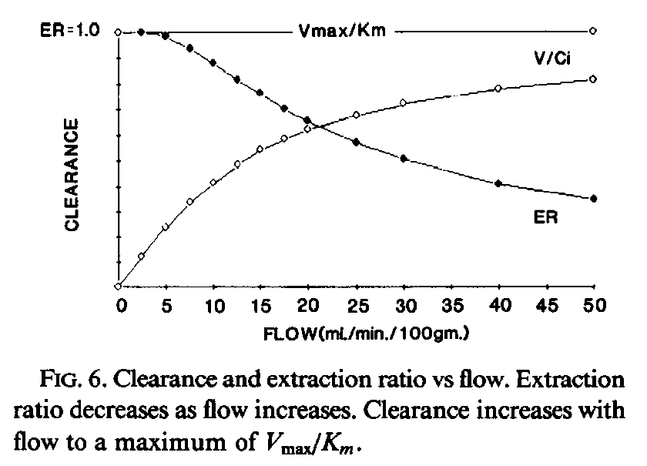
Work in Progress
TODO: Improving Integration Times
generation of optimized C++ code for solver

Slide 20
Cellular Scale - Hepatocytes

Slide 21

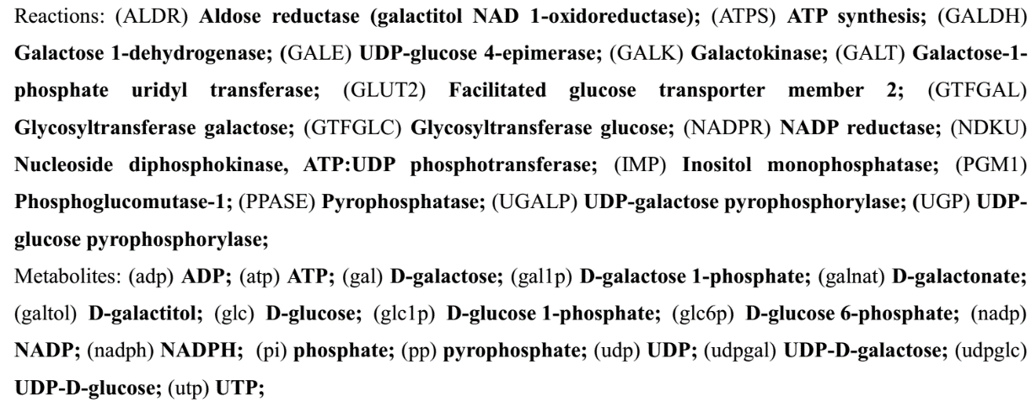
Galactose Metabolism
liver most important organ for whole-body metabolism and clearance of galactose
Main enzymatic steps
Galactokinase (GALK) phosphorylation of galactose (gal) to galactose 1-phosphate (gal1p) catalysed
Galactose-1-phosphate uridyl transferase (GALT) conversion of gal1p to UDP-galactose (udpgal)
UDP-galactose 4´-epimerase (GALE) interconversion of udpgal and UDP-glucose (udpglc)
Galactose can enter glycolysis as glucose-1 phosphate (glc1p)
Galactose can be incorporated in glycoproteins and glycolipids as udpgal

Slide 22
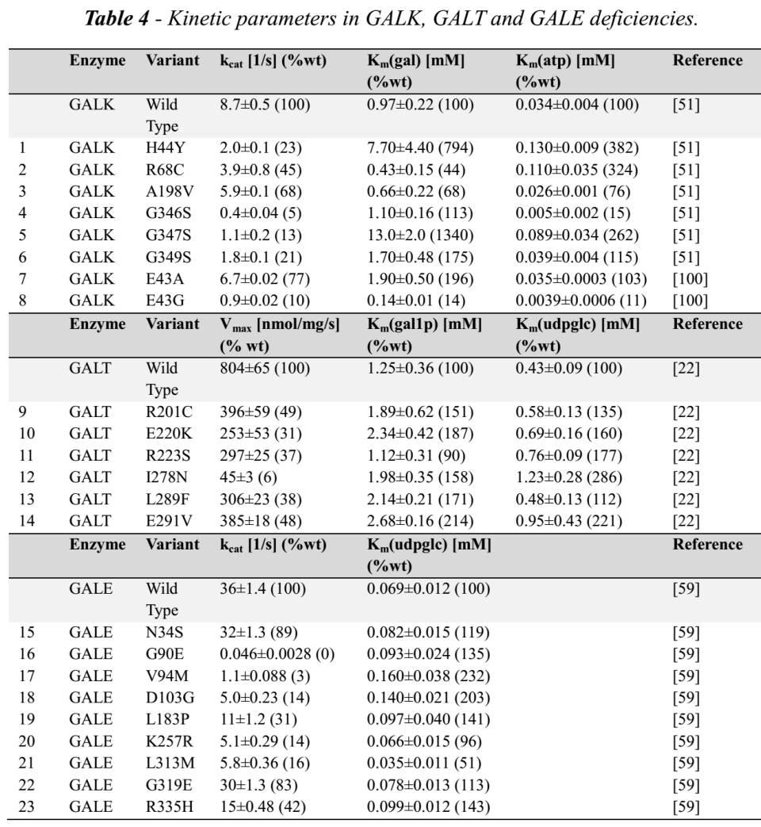
Galactosemias
caused by deficiencies in either GALK, GALT or GALE
untreated as well as treated patients with galactosemia show accumulation and/or depletion of specific metabolites, and often abnormalities of glycosylation
implementation
via measured alterations in kinetic properties in human protein mutations

Slide 23
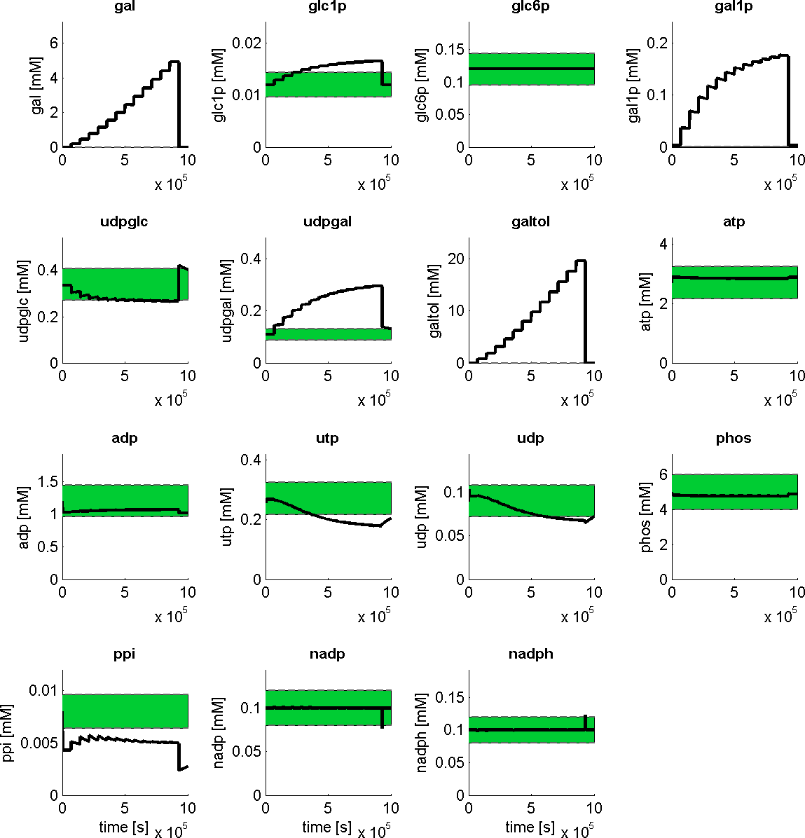
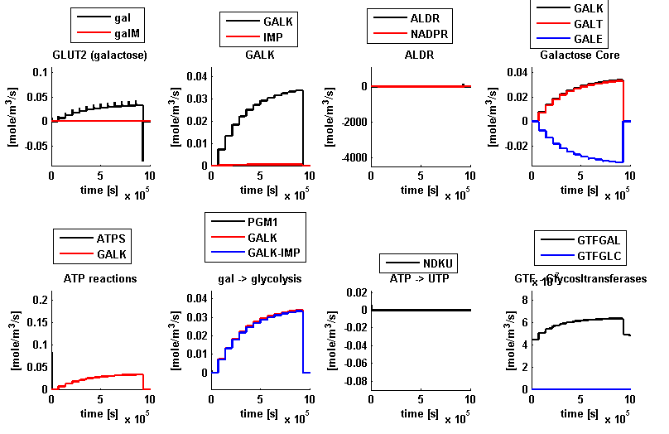
Hepatocyte Model
Reproduces
metabolic concentrations normal state
altered metabolite levels during galactose challenge
saturation of clearance capacity

Slide 24
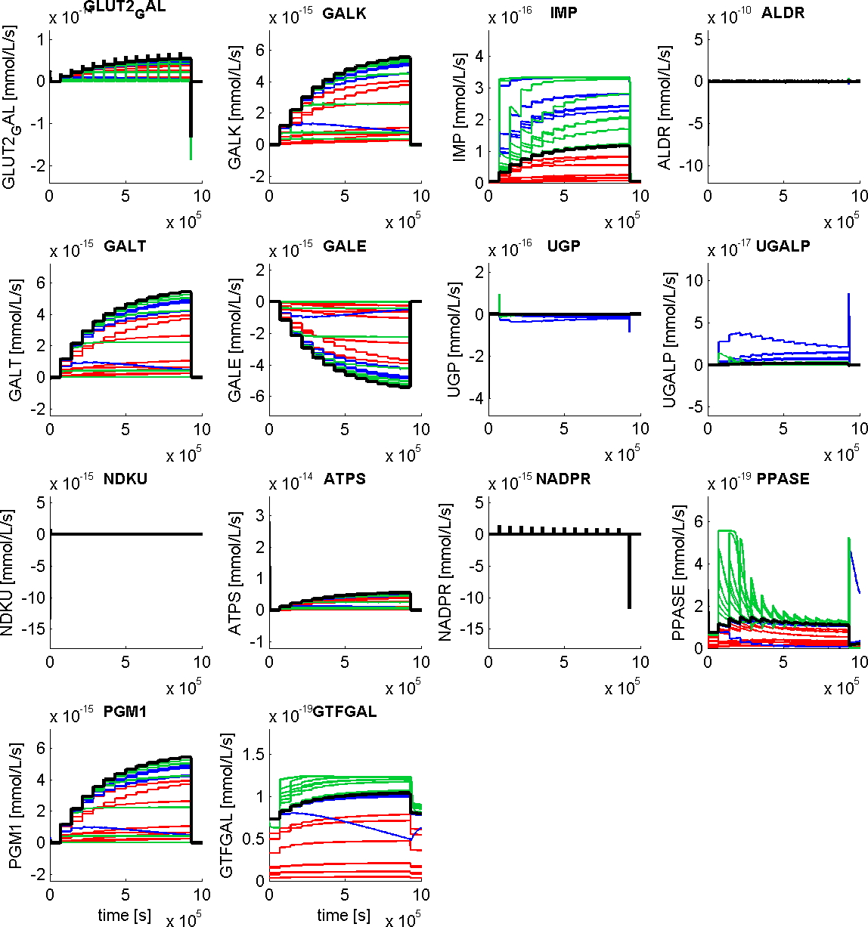
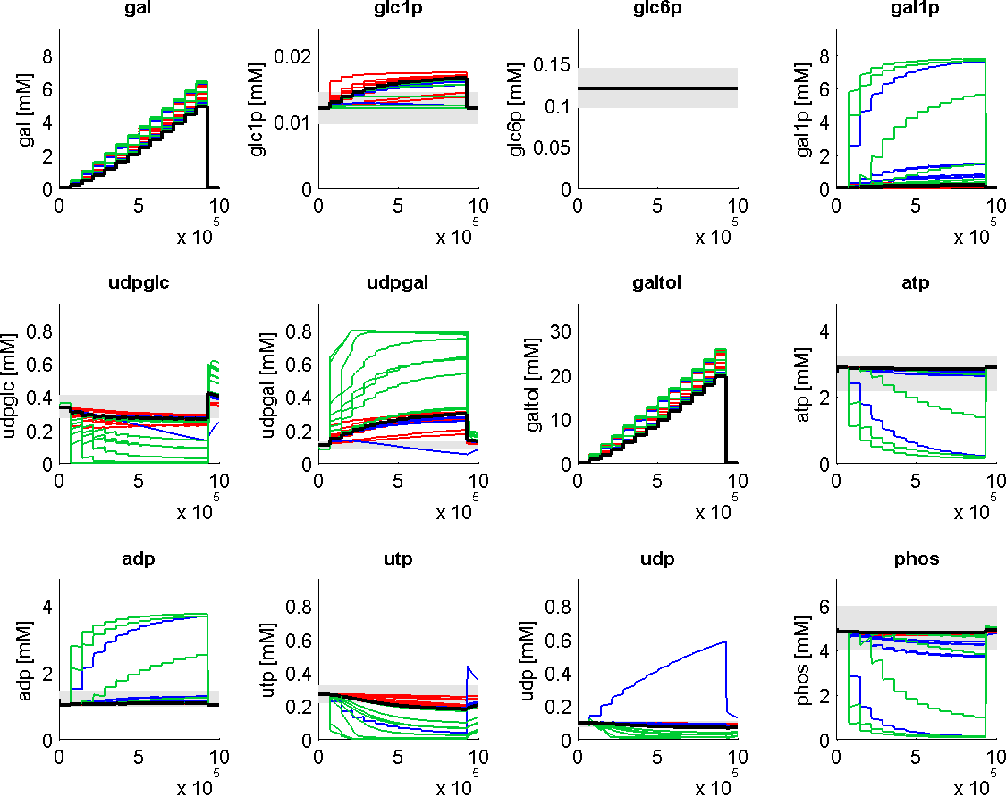
Galactosemia (GALK, GALT, GALE)
marked alterations in metabolite levels
galactitol accumulation
shift of udpglc/udpgal level
reduced galactose clearance
energetically challenged

Slide 25
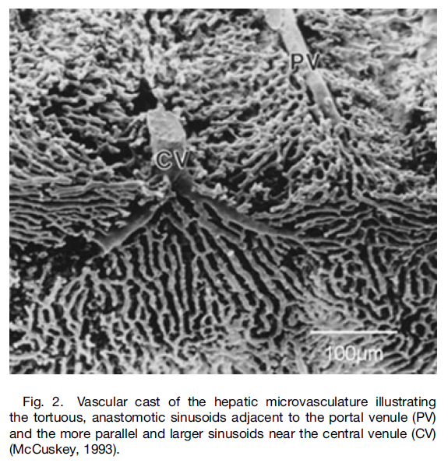
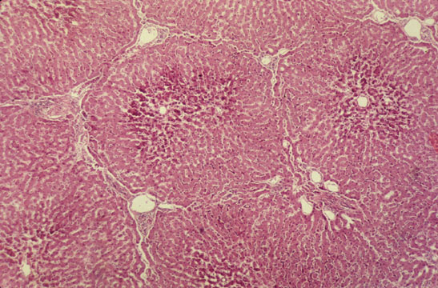

Slide 26
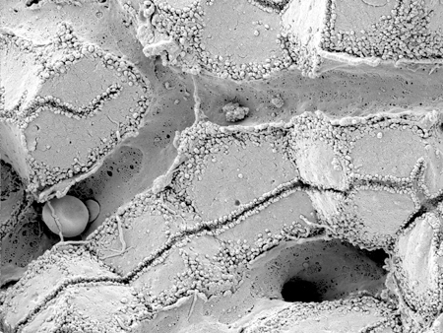
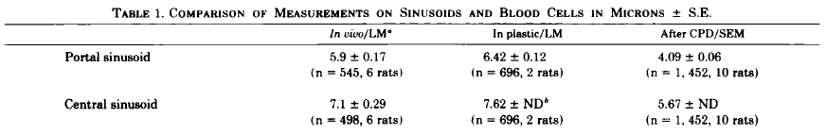
Sinusoid
Scanning electron micrograph showing fenestrated sinusoids and hepatocytes in a mouse liver.
http://www.easloffice.eu/jhep/contest/website/see_photos.html
principal vessels for exchange between blood and hepatocytes
~ 6-8µm diameter
periportal sinusoids are narrower and more tortuous than the wider and straighter central ones
Sinusoid network is heterogeneous
near portal vene arranged as interconnecting polygonal networks
farther away from portal vein organized as parallel vessels terminating in the central vein
short intersinusoidal sinusoids connect adjacent parallel sinusoids
Scanning electron microscope observations on the structure of portal veins, sinusoids and central veins in rat liver. Wisse, E.; De Zanger, R. B.; Jacobs, R. & McCuskey, R. S.; Scan Electron Microsc, 1983, 1441-1452
The liver sieve: considerations concerning the structure and function of endothelial fenestrae, the sinusoidal wall and the space of Disse. Wisse, E.; De Zanger, R. B.; Charels, K.; Van Der Smissen, P. & McCuskey, R. S. Hepatology, 1985, 5, 683-692

Slide 27
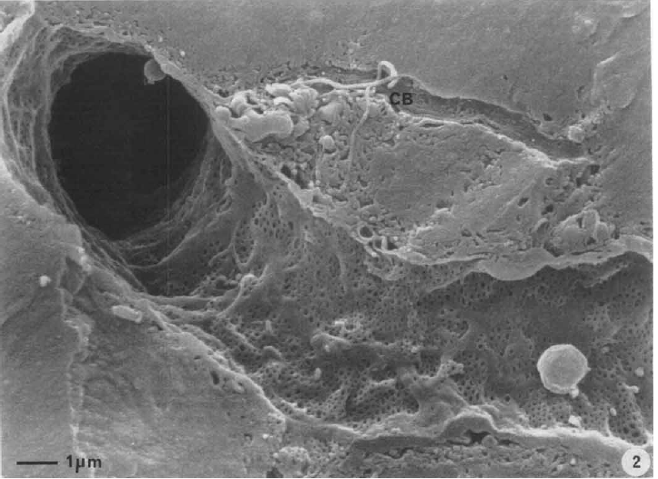
Endothelial Fenestrae
liver sinusoids unique capillaries
open pores (fenestrae) in sinusoidal wall
lack basal membrane underneath endothelium
fenestrae act as sieving barrier between blood and heptocytes
morphological & physiological evidance that fenestrae act as a dynamic filter
important role in lipid metabolism (namely chylomycrons)
Liver sinusoidal endothelial cells (LSEC) constitute sinusoidal wall
numerous endocytotic vesicles
effective uptake of a wide variety of substances from blood via receptor-mediated endocytosis (Braet, 2004)
transcytosis transport across the endothelium to surrounding tissue
scavenger system
Contribution of high-resolution correlative imaging techniques in the study of the liver sieve in three-dimensions. Braet, F. et al; Microsc Res Tech, 2007, 70, 230-242
Structural and functional aspects of liver sinusoidal endothelial cell fenestrae: a review. Comp Hepatol, Braet, F. & Wisse, E., 2002, 1, 1
The liver sieve: considerations concerning the structure and function of endothelial fenestrae, the sinusoidal wall and the space of Disse. Wisse, E.; De Zanger, R. B.; Charels, K.; Van Der Smissen, P. & McCuskey, R. S. Hepatology, 1985, 5, 683-692

Slide 28
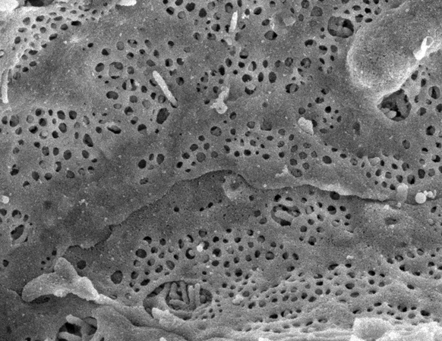
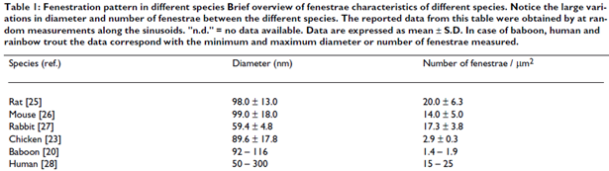
Fenestrae
Scanning electron micrograph of hepatocyte microvilli protruding through the sinusoidal endothelial cell fenestrations.
diameter ~50-200nm
ultrastructure same across species
groups of fenestrae arranged in so called sieve plates
differences periportal & perivenious
diameter decreases (110.7 to 104.8nm)
frequency increases (9 to 13 per µm²)
increased porosity from pp to pv from 6 to 8%
number and diameter may vary between individuals & within single indiviuum under various physiological and pharmacological circumstances

Slide 29
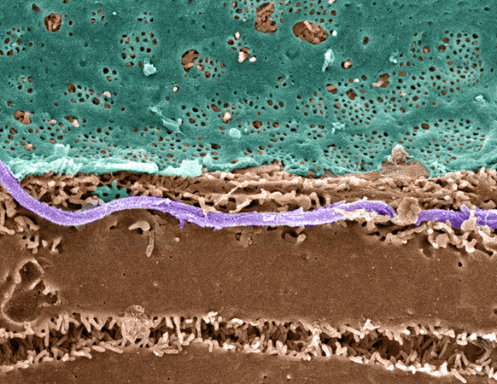
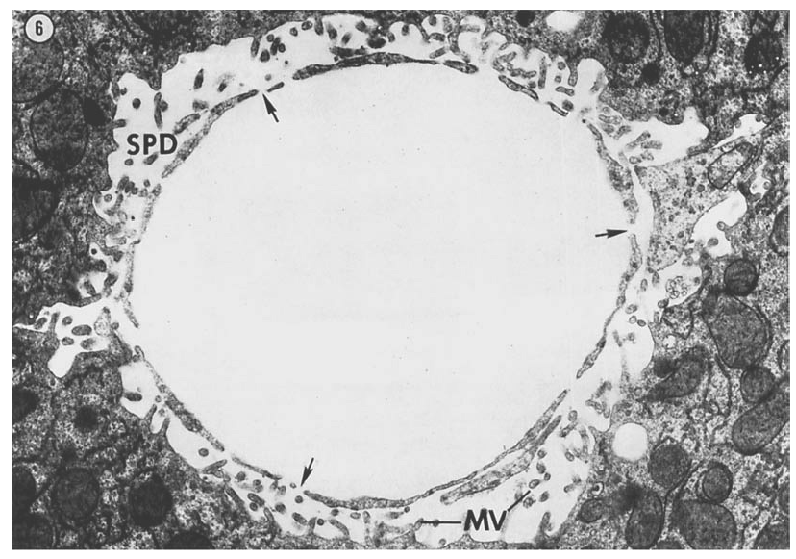
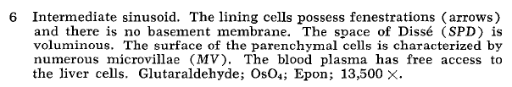
Space of Dissé
Pseudo-colored Scanning EM of an hepatic plate, accentuating the fenstrated sinuoidal endothelium (blue), hepatocyte (brown) and a collagen fibril (lavender).
Hepatocytes surface enlarged via microvilli.
The fine structure of rat liver sinusoids, space of Dissé and associated tissue space. Burkel, W. E. & Low, F. N.; Am J Anat, 1966, 118, 769-783
http://www.easloffice.eu/jhep/contest/website/see_photos.html

Slide 30
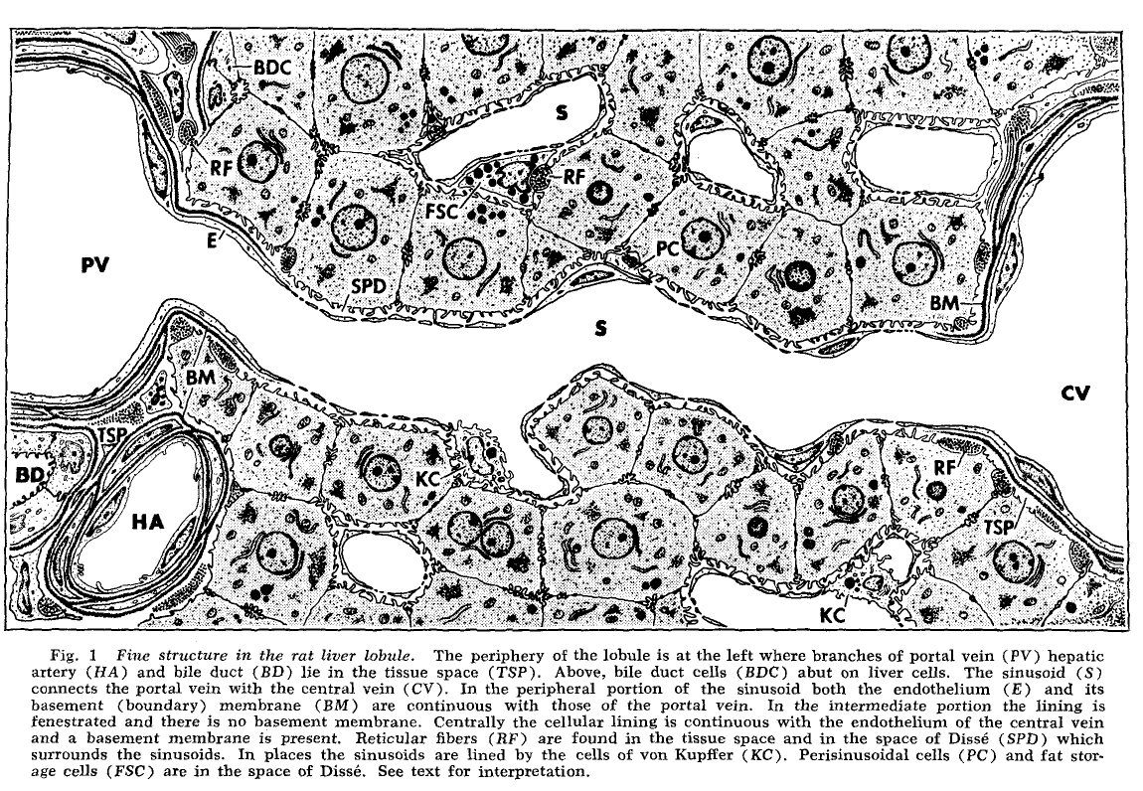
Sinusoid Ultrastructure
fenestraetion & absence of basement membranes provide direct access of blood plasma to hepatocytes
The fine structure of rat liver sinusoids, space of Dissé and associated tissue space. Burkel, W. E. & Low, F. N; Am J Anat, 1966, 118, 769-783

Slide 31


Tight Sinusoids
The liver sieve: considerations concerning the structure and function of endothelial fenestrae, the sinusoidal wall and the space of Disse. Wisse, E. et al; Hepatology, 1985, 5, 683-692

Slide 32

Blood Flow
The terminal hepatic microcirculation in the rat. Koo, A.; Liang, I. Y. & Cheng, K. K.; Q J Exp Physiol Cogn Med Sci, 1975, 60, 261-266
Intermittence of blood flow in liver sinusoids, studied by high-resolution in vivo microscopy. MacPhee, P. J.; Schmidt, E. E. & Groom, A. C.; 1995, 269, G692-G698

Slide 33


Blood Flow
The terminal hepatic microcirculation in the rat. Koo, A.; Liang, I. Y. & Cheng, K. K.; Q J Exp Physiol Cogn Med Sci, 1975, 60, 261-266
Intermittence of blood flow in liver sinusoids, studied by high-resolution in vivo microscopy. MacPhee, P. J.; Schmidt, E. E. & Groom, A. C.; 1995, 269, G692-G698

Slide 34

Lymph
substantial amount of hepatic lymph is generated in space of Dissé
space of Dissé is continuos with the tissue space at both ends of the sinusoid !
high protein content of hepatic lymph
lymphatic vessels originate as blind-ending capillaries in the connective tissue spaces (portal tracts) associated with the portal veins and hepatic arteries
fluid contained in these lymphatics flows toward the hepatic hilus and eventually into the cisternae chyli
Lymph circulation in the liver. Ohtani, O. & Ohtani, Y.; Anat Rec; 2008, 291, 643-652
The lymphatics of the liver. Trutmann, M. & Sasse, D. ; Anat Embryol (Berl), 1994, 190, 201-209

